Slide 1
Work-in-Progress: Utilization Based Schedulability Analysis for Wireless Sensor-Actuator Networks
Dali Ismail, Mahbubur Rahman,
Venkata P Modekurthy, Abusayeed Saifullah
Department of Computer Science
Wayne State University
RTAS 2017

Slide 2
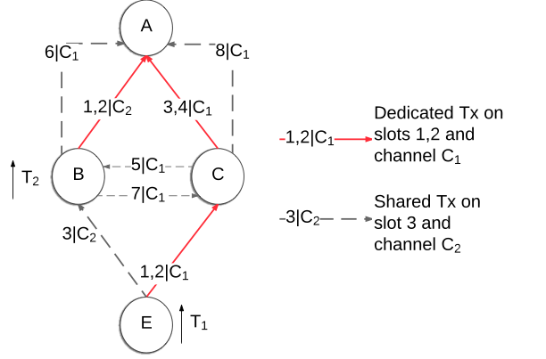
Motivation
Existing sufficient tests are based on end-to-end delay bound.
These algorithms run in pseudo-polynomial time.
T₁=12, D₁=8 & R₁= 6
T₂=12, D₂=12 & R₂= 6
Schedulable
2

Slide 3
Challenges
Can we adopt a utilization based approach for schedulability?
Challenges (difference from CPU scheduling)
Simultaneous transmissions on different channels
Transmission conflict
3

Slide 4
Utilization Based Analysis for multi-hop network
Mapping
1 TDMA Time slot $↔$ 1 Time unit
Channel $↔$ Processor
Delay due to transmission conflict can be treated as blocking in non-preemptive scheudling
4

Slide 5
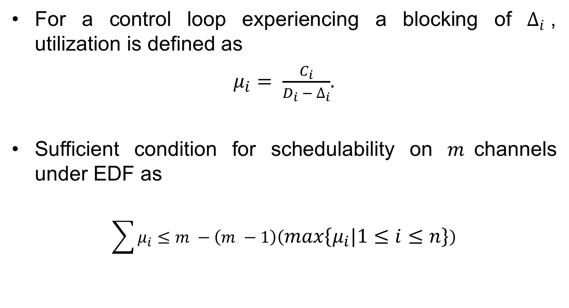
Utilization Based Analysis for multi-hop network
For a control loop experiencing a blocking of $∆_{i}$, utilization is defined as
$μ_{i}= \frac{C_{i}}{D_{i} − ∆_{i}}$.
Sufficient condition for schedulability on $m$channels under EDF as
$$\sum{μ_{i}}≤m −\left(m −1\right)\left(max\left\{μ_{i} | 1≤i≤n\right\}\right)$$
5

Slide 6
Thank You! For further information, come meet us at the poster.
6

