Slide 1
Making Android Run On Time
Yin Yan¶, Karthik Dantu¶, Steven Y. Ko¶,
Jan Vitek†, Lukasz Ziarek¶
¶ State University of New York at Buffalo
†Northeastern University
http://rtdroid.cse.buffalo.edu
Notes:
Good morning everyone, my name is Yin Yan from SUNY buffalo. The work I am going present today is about how to make android run on time. The rest of the authors on the paper are Prof. Karthik dantu, Prof. Steven Ko, Prof. Jan Vitek and Prof. Lukasz Ziarek.

Slide 2
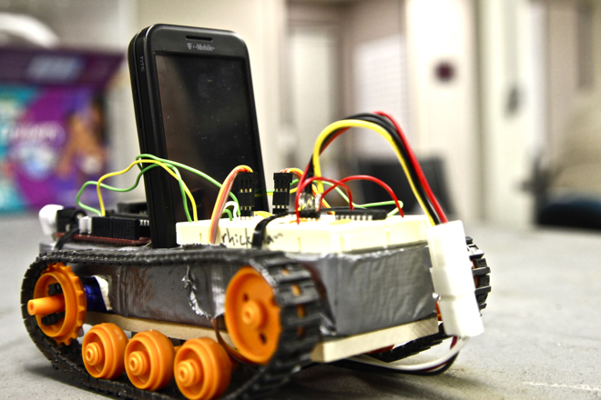
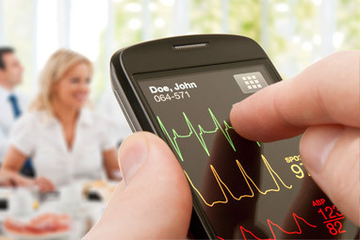
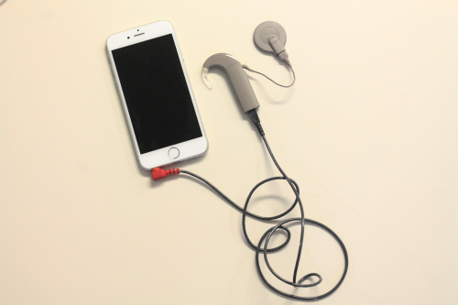
Motivations
Open source project
Well-defined APIs
Rich on-device peripherals
How can we write a real-time application on Android, while still leveraging its existing functionalities?
Notes:
As we know, Android is a open source project, it has well-defined programming interfaces and allows developers easily access to rich set of on-device peripherals. All of these features encouraged developers port Android for traditional embedded applications.
Recently, lots of interests have been raised to adapt Android in real-time context as well. Like use android-equipped device as the control unit in robotics. in health industrial, people are interested in integrating Android device into their existing health care system. For example, a research platform has been built for researcher … all of these application to some extent require real-time capability.
“how can we write a real-time application on Android and still leverage all features listed on the slides?”
In the rest of my talk, I will use the cochlear implanted application as an example. To explain what is missing on the stock Android。 And how our solution address them.

Slide 3
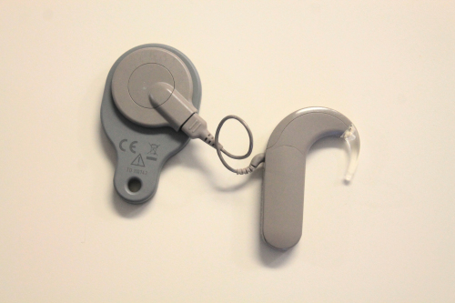
Cochlear Implant Device
Cochlear implant as an example
An external device for audio recording and processing
Implanted electrodes with hearing nerves
Notes:
Before …. A little bit background.
A cochlear implant device is an handicap assistant device that can restore the hearing ability. It mainly includes two parts: a external record audio capturing and processing, and an implanted electrodes to simulate hearing nerves.

Slide 4
Architecture of Cochlear Implant Application^{[1]}
Non Real-time components
Real-time components
UI Activity
Audio Recorder
(Service)
Periodic Audio Recording Task
Volume Receiver
Audio Processor
(Service)
ButtonListener
MsgHandler
Periodic Audio Processing Task
8 ms
UI Handler
Output Simulator
(Broadcast Receiver)
[1] FPGA-based cochlear implant controller, http://www2.ee.washington.edu/faculty/hauck/FPGA_Cochlear
Notes:
When we implement this cochlear implant application as Android application. The smartphone is used for the external audio recording and processing.
Based on the application abstraction provided by Android, conceptually, we can divided the application into four components, 1) an activity for user interactions, 2) an audio recoding service 3) an audio processing service, 4) and an output signal receiver.
The real-time requirement of this application is that the a fixed set of recorded audio samples has to be processed very 8 ms.

Slide 5
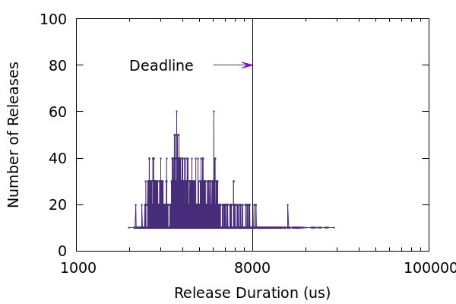
Preliminary Results of Cochlear Implant Application
12% of audio processing duration is longer than 8 milliseconds.
Cochlear Implant: Audio Processing Duration
Notes:
OK. Now let us take a look if the timing requirement can be achieved on a stock Android smartphone. We conduct a preliminary experiment with this application 。。。。Why? x-asix: processing duration, y-asix: the frequency of the processing duration
12.89 %

Slide 6
What Is Missing in Android?
Non Real-time components
Real-time components
Lack of real-time expressiveness
Can’t prioritize the execution of application components
Can’t specify real-time configuration
Lack of real-time communication
No priority awareness for message/intent delivery
No protection mechanism for cross-context communication
Lack of memory guarantee
UI Activity
Audio Recorder
(Service)
Periodic Audio Recording Task
Volume Receiver
Audio Processor
(Service)
ButtonListener
MsgHandler
Periodic Audio Processing Task
UI Handler
Output Simulator
(Broadcast Receiver)
Notes:
To understand the reason why these 12% data miss their deadline, let’s take a careful look of the previous application architecture.
First of all, it is not surprising that Android application’s application components can’t express real-time requirement. Essentially, there are at least three real-time threads in the cochleae implant application. Audio recording task, processing task and receiver. How can I prioritize them, and how can I make sure the execution of real-time components in the blue boxes is always over the non-real-time ones in green boxes.
More importantly, the programming model of Android is event-driven, all components are triggered by via message passing or intent broadcasting. It is crucial to enable priority-awareness in these communication mechanism. For example, the message handler …, and intent broadcasting, we want to separate the priority the audio processing task and the output receiver. So all of these require built-in priority policies for communication.
However, the problem will became much more complicated in the cross-context. We need to isolate the interference from non-RT component.
(click) in some extreme case, the non RT UI can consume most of the memory in heap, indirectly delay the object allocation in real-time by enforcing the execution of garbage collection. Thus, we need to address memory guarantee for real-time component as well.

Slide 7
Solution: A New Programming Model in RTDroid
Declarative real-time components
Real-time communication channel
Memory guarantee with region-based allocation
Design principles:
Retains a similar application style of Android
Minimizes code complexity in application
Enables application validation with real-time configuration prior to execution
Android Apps
RT app
Android
Applications
RTDroid
Applications
Android Framework
RTDroid Framework
Dalvik / ART
Fiji Java VM
Android Linux Kernel with RT Patch
[1] RTDroid: A Design for Real-Time Android in the 11th International Workshop on Java Technologies for Real-Time and Embedded Systems (JTRES) 2013
[2] Real-Time Android with RTDroid. In the International Conference on Mobile Systems, Applications, and Services (Mobisys) 2014
[3] (Journal) RTDroid: A Design for Real-Time Android in the IEEE Transactions on Mobile Computing (TMC)
[4] Real-Time Sensing on Android inn The 12th International Workshop on Java Technologies for Real-time and Embedded Systems (JTRES) 2014
Notes:
To address all of these problems, we present our solution as a real-time programming model built upon a project, called RTDroid. The previous RTDroid supported a single application execution with real-time kernel and real-time java VM in an isolated environment. Can’t interaction with android components.
The contributions of this work are following:
We provide an android-like programming model for the development of real-time applications, it provides 1) 2) 3) while still allowing real-time application to leverage the existing functionalities in Android.
There are three features:
1) Provide declarative real-time components 2) Provide four types of communication channels that provide control over how components to communicate in real-time context, as well mechanisms to interact with non real-time functionalities in Android.
3) At the same time, to avoid non-real-time interruption on memory management, we use region-based allocation to enforce memory guarantees of all real-time components.
I will explain design details in the following slides. There are three design principle that guide throughout the design over our programming model.

Slide 8
Declarative Real-Time Components in RTDroid
<service name="pkg.ProcessingService“ priority="79">
<memSizes persistent="1M"
release="1M" />
<periodic-task name="procTask“ priority="79">
<release start="0ms" periodic="8ms" />
</periodic-task>
…
</service>
Real-time components
Real-time service
Real-time broadcast receiver
Periodic task
Application manifest with real-time schema
Priority
Timing parameters
Memory bounds
Service
+ onStartCommand()
+ onBind()
+ onCreate()
+ onDestroy()
BroadReceiver
+ onReceive(…)
RealtimeReceiver
+ onClean()
RealtimeService
+ onPause()
PeriodicTask
+ onRelease()
Notes:
For real-time expressiveness, we provide real-time service/receiver, which are derived from android components, and we add periodic task for …. As Android application required, all real-time components must declare in an application manifest file. We expand the manifest schema with real-time extension.
This declarative model serves two purposes：1）it decouples the application logic and real-time requirements. The real-time related complexity are almost provided by our framework work with rt configuration. These information then can be used for application validation as well prior to execution.
For example, (click) , the processing service, its priority and timing parameters for task scheduling. The memory guarantee is defined as memory bound through an element called mem-size. I will talk about it later in details.
(From developer’s point of view, developers just need to declare memory bound of each component with memSize, the rest is transparent to developers. )
With all of the memory bounds in an application, we can reason if there are enough memory for all real-time components to execute.
==============================================
As the slide lists, we provide real-time service and broadcast receiver. They inherited semantic of Android component. The real-time service is used for …, the RT receiver is used for … An additional periodic task is added to express the periodic logic in real-time context. I also extend the schema of Android application manifest, developers have to specify all real-time configuration in the application manifest. Here is a part of code snippet for the Processing Service as an example. We add additional sub-elements and attributes for timing parameters and memory usage quotation. All of these real-time configuration are used for RTDroid static analysis for scheduability and memory usage.
============================================================================================
The lifetime management of RTDroid components are similar to Android by trigging the callback functions on the components via events from system or other applications. For example,
Notice that We don’t consider UI to be a real-time component. Instead, we allow for interactions between non-real-time UI components and real-time components through our message channels.
Difference between android and RTDroid, the RTDroid’ real-time components run in their own thread in order to assign priority individually. Periodic task is a sub-component of real-time service for periodic computation.
Notice that We don’t consider UI to be a real-time component. Instead, we allow for interactions between non-real-time UI components and real-time components through our message channels.

Slide 9
Real-Time Communication Channels in RTDroid
Four types of communication channel
Real-time message passing channel
Real-time intent broadcasting channel
Real-time bulk data transfer channel
Cross-context channel
Communication policies
Message delivery order
Message process / component invocation
Message constraints
<channel name=“msghandler” type=“msg-passing”>
<!-- message delivery and processing policies -->
</ channel>
<service name="pkg.RecordingService" priority=“78">
<intent-filter count="2" role=“publisher">
<action name="msghandler"/>
</intent-filter>
</service>
<service name=" pkg.ProcessingService " priority=“79">
<intent-filter count="2" role=“subscriber">
<action name="msghandler"/>
</intent-filter>
</service>
Notes:
For communication, we provide four types of communication channels.
The first three channels must be declared before used, the declaration of a real-time channel contains real-time policies for delivery order, processing order, other constrains.
To send and receive message, a real-time components must declare itself as a subscriber or a publisher with an integer which specifies the number of message the component will send/receiver per execution. we add this constrain because each component specifies its memory bound. So we can’t allow arbitrage messaging sending/receiving. Otherwise, memory bound will be blowup. Thus, We can verify the message processing can keep up with message queuing.
At last, for the cross-context channel, a singleton instance of it is created by default to facilitate interaction with other Android applications and system services.

Slide 10
Memory Guarantee in RTDroid
Region-based memory management with constant cost for object allocation and reclamation.
Based on the concept of the scoped memory in RTSJ
The complexity of region management is hidden in our program model
The lifetime management of scope is associated with the lifetime of each application component.
Immortal scope
Objects that have the same lifetime as the application does
Persistent scope
Objects that have the same lifetime as its associated component does
Release scope
Temporary objects for the execution of callback functions
Notes:
RTDroid programming model uses the region-based memory allocation for memory management.(click) besides of the application validation, the other benefits of it is that the cost of object allocation and deallocation is always constant.
(click) our region-based allocation is derived from the concept of scope in RTSJ. Given to the experiences with RTSJ scope, we hide all of the complexity of this region management within our framework.
We are able to do this because the lifetime of our scope is associated with the lifetime of each application component.
We have three types of scopes in our programming model：
immortal scope …; Each real-time component has its own persistent and release scope. The persistent scope is used to allocated objects with the same lifetime as the owner component, the release scope is used to allocated temporary objects for execution.

Slide 11
Region-Based Memory Management in Cochlear Implant
Processing Service
Output
Receiver
Heap
Memory
(FijiVM)
Heap
Memory
(ART/Dalvik)
Release
Release
Android
Adaptor
UI Activities
Persistent
Persistent
Immortal Scope
RTDroid
Proxy
RT Channels
Real-time Runtime in RTDroid
Non Real-time Runtime
in Android
Notes:
Here is the simplified example of the cochlear application as example.
All the objects has the application lifetime is in the immortal scope, like the RT channels and other auxiliary system objects as well.
Each component has their own release and persistent scope. Recall, I said there is a message queue per channel for message delivery from channel. Thus, the message objects are copied from sender’s memory scope to receiver’s scope.
For cross-context communication, (click) it is divided into two parts: the RTDroid part has an adaptor component , it prevents flooding messages into real-time context by storing all messages from non-real-time components from Android and send non-real-time messages to real-time channel if and only if the receiving component is wiling to process one.

Slide 12
Evaluation
Real-time expressiveness
Code complexity comparison between RTDroid and RTSJ
Real-time communication and predictable memory management
Message delivery latency of channel micro benchmarks
Application processing latency
A simulated cochlear implant application
An UAV flight control application
A turbine health monitoring application
Notes:
In evaluation section, we provide two measurement matrices.
Firstly, to verify the expressiveness, we provide code complexity comparison between RTDroid and RTSJ.
Secondly, for predictability, we conduct a number of micro benchmarks with message delivery latency and three applications with processing latency in real-time/critical component. For time limit, I will only show one result from micro-benchmark and one application with code matrix.

Slide 13
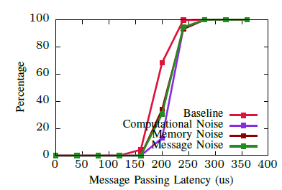
Evaluation: Channel Micro Benchmarks
A sender service, a receiver service
A noisy making service starts a number of noisy making threads
Memory noise: 512KB objects every 200 ms.
Computation noise: computes Pi every 200 ms.
Message noise: a low-priority message to the receiver every 200 ms.
Fig1. CDF of Message Passing Latency
Notes:
For the channel micro benchmarks. To verify the predictability of our implementation, we did a number of stress tests with
three types of noise, including memory stress, computation noise and message noise from low-priority component.
On the slide, the plot shows a CDF of message passing latency over a collection of 2000 messages, all experiments were executed with 30 noise making threads. As the plots shows all of curves with different types are similar, the highest observed message passing latency is about 270 micro-seconds.

Slide 14
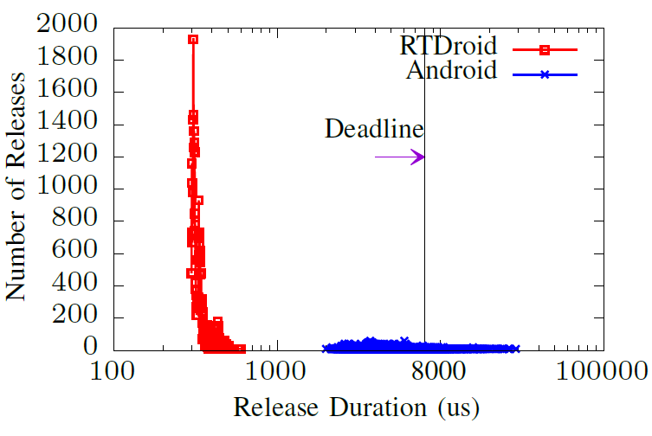
Evaluation: Predictability in Cochlear Implant Applications
Fig.2 Audio Processing Duration
Notes:
To provide a more comprehensive evaluation, we implemented three application.
The x-axis is audio processing time in log-scale. As the plot shows, compare to Android, the processing durations in RTDroid are more constant, most of them take around 200 micro-seconds to 300 micro-seconds. Because 1) 2) 3)

Slide 15
Evaluation: Code Complexity in Cochlear Implant Application
Application | Type of Code | SLoC | Syn | Manifest
Cochlear Implant | Common RTSJ RTDRroid | 175 256 235 | 0 4 2 | 0 0 69
jPapaBench | Common RTSJ RTDRroid | 3,844 300 230 | 0 6 0 | 0 0 149
Wind Turbine | Common RTSJ RTDRroid | 1,387 539 387 | 3 9 0 | 0 0 52
Table.1 Code Complexity Measurement
Notes:
For code complexity, we compare our programming model to rtsj and report three numbers, including lines of code and the number of synchronization blocks
8%, 23% and 28%
David A.Wheeler’s SLoCCount

Slide 16
Work in Progress
Reduces the overhead of message object delivery by implementing transfer scope
Explores other possibilities for application verification with our real-time configuration in manifest
Eventually, replaces region-based memory management with a real-time garbage collector that can be analyzed with worst case execution time.

Slide 17
Conclusion
Our work provides a programming model for real-time application development on Android.
Real-time abstractions
Real-time communication channels
Region-based memory management .
Visit us: http://rtdroid.cse.buffalo.edu
Questions?

Slide 18
Notes:
Transit to the next slide: in the following slides, I will use a simulated cochlear plant application developed on Android to explain why the existing Android application abstractions are not sufficient for real-time application development. Then, I will demonstrate how RTDroid’s programming model can extend it with these above features.

Slide 19
Real-Time Declarative Manifest in RTDroid
Real-time Constructs | XML Tags | Attributes / sub-elements
Real-time service | <service> | Attributes: name, priority Sub-elements: <memSize>: memory bounds; <release>: timing configurations, <periodic-task>: sub-compnents, <intent-filter>: channel subscription
Real-time receiver | <receiver> | Attributes: name, priority Sub-elements: <memSize>: memory bounds, <release>: timing configurations, <intent-filter>: channel subscription
Real-time channel | <channel> | Attributes: name, type: (msg-passing|broadcasting|bulk-data), size Sub-elements: <data>: message specification, <order>: message queueing order, <execution>: the execution priority of the callee, <drop>: the message dropping policy

Slide 20
Implementation of RT Message Passing Channel
Sender 1
Persistent
Receiver 1
Persistent
Receiver 1
Persistent
Sender 1
Release
Receiver 1
Release
handleMsg(){
//process msg
}
Sender 2
Release
M
M
M
M
copy
copy
Immortal Scope
RT Message Channel

Slide 21
Lack of Real-Time Expressiveness
Application logic is implemented as callback functions.
Can’t prioritizes the execution of the callback functions of the component.
Can’t Specify real-time configuration in Android application manifest.
Call to
startService()
onCreate()
onStartCommand()
Shut down
onDestroy()
Running
Notes:
The first aspect is the lake of real-time expressiveness, As we know, Android’s components are implemented as a set of abstract callback functions.
There are APIs to invoke these callback functions and change the state of each component. However, …

Slide 22
Lack of Predictability in Memory Management
It is not surprising that the garbage collector in Dalvik / ART is not suitable for real-time usage.
How can we guarantee that the garbage collection execution can always keep up with application execution?
The low-priority task can block the high-priority task by stressing GC.
Notes:
At last, it is about the memory management. …

Slide 23
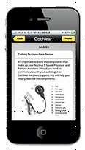
Difficulties: Unpredictable Memory Management
How can we guarantee that the garbage collection execution can always keep up with application execution?
The low-priority task can block the high-priority task by stressing GC.
Non real-time components can deny the real-time service by flooding message to the receiving components
Low-priority component
High-priority component
Free space
Alive objects
GC Task
Dead objects
Heap Memory
ProcessingService
…
Notes:
Now let’s take a careful look of the previous application architecture.
Lack of real-time expressiveness
Lack real-time communication mechanism
Unpredictable memory management

Slide 24
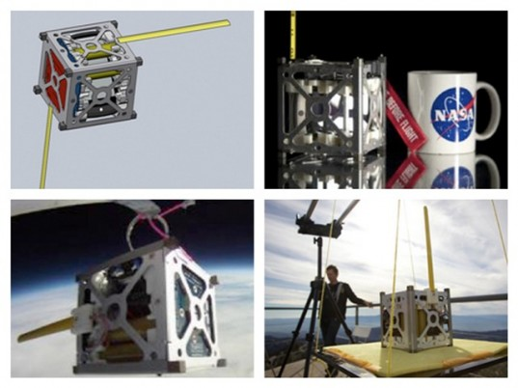
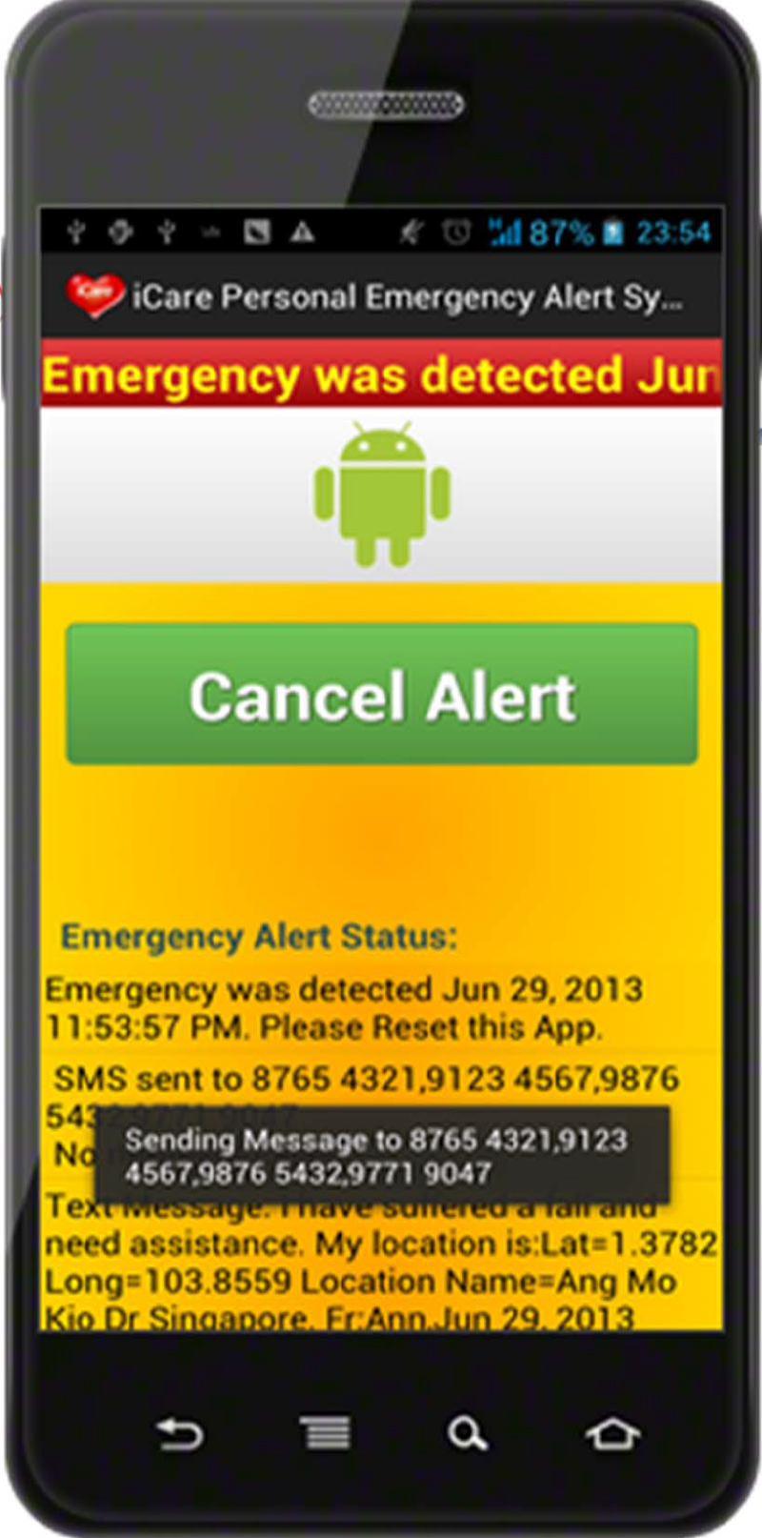
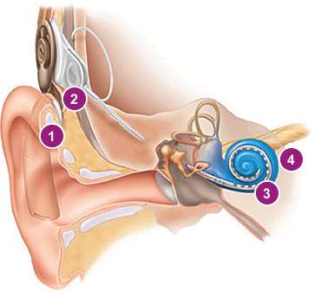
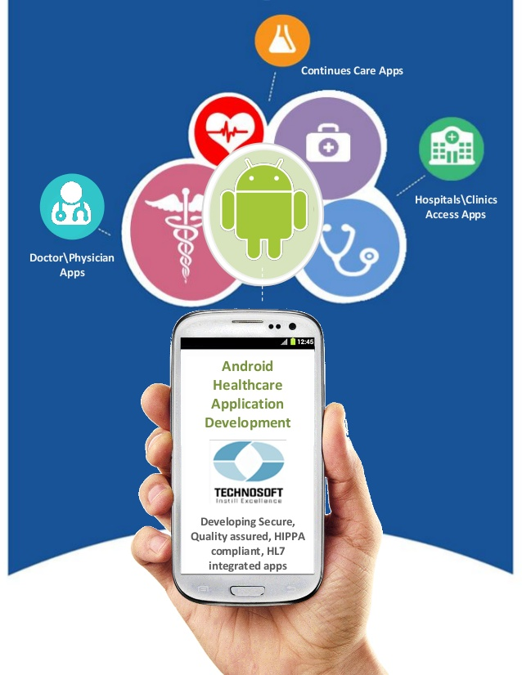
Real-time Applications on Android
Aerospace
Health Care
[1] UK nano-satellite http://www.sstl.co.uk/
[2] PhoneSat http://www.phonesat.org/
[1] Android Emergency Alert with Fall Detection http://goo.gl/ITQsW0
[2] Simulated cochlear implant application
[3] PathCare http://goo.gl/G5UXq & Mentor Graphic http://goo.gl/DYVOtq
Notes:
The motivation of this is that recently there are lots of interests have been raised to use Android in the real-time context. For example, in aerospace, …; in health industry, … health monitoring system. For instance, to reduce the number of user’s carry-on devices, a personal emergency alter system have been developed for falls detection of senior people and wooded soldiers. Similarly, some researchers have also implemented a simulated environment to quickly try out different signal processing algorithms for their cochlear implant device.
Notice that all of these application require some extend of real-time capabilities, which can guarantees the execution of the real-time components, while schedule the rest of non real-time components with best efforts. So, the question left here is does Android provide any such ability？ If Not, how can we to add real-time capability to Android.

