Slide 1
Work-in-Progress: Wireless Network Reconfiguration for Control Systems
Wenchen Wang, Daniel Mosse, Daniel Cole, Jason G Pickel

Slide 2
Wireless Control System (WCS)
Actuator
Plant
Sensors
Delay and Message Loss
control signal
measurements
Remote
Controller
Performance Degradation
Delay and message losses can induce additional error, network-induced error
Wired control system output
Network-induced error
output
Wireless control system output
time
Notes:
Wireless control system is the control system connected by wireless network. One of the major challenge of wireless control system is performance degradation for control system, which caused by the the network delay and message loss. Network-induced error is the difference between wired control system output and wireless control system output.

Slide 3
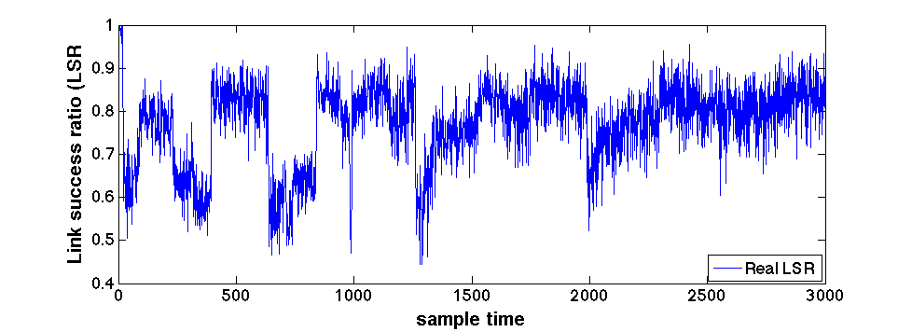
Problem Statement
Trade-off between delivery ratio and delay
Higher delivery ratio ➔ more redundant nodes ➔ more delay
Optimal network configuration
Time-correlated link failures [Baccour TOSN’12]
Network reconfiguration
Objective: network-induced error reduction
Solution: network reconfiguration framework
Notes:
We found that there is a trade-off between delivery ratio and delay. The higher delivery ratio, the more redundant nodes needs to put in the network, but will cause more network delay. This motivates us to study this tradeoff and find optimal network configuration. Another difficulty is that network interference and noise produce time-correlated link failures. This is the link success ratio measured by other people. The link quality changes over time, which motivates us to study network reconfiguration at run time. We propose a network reconfiguration framework to reduce the network-induced error.
We found that there is a trade-off between delivery ratio and delay. This motivates us to find an optimal network configuration with minimize the network-induced error.
Another difficulty is interference and noise can produce time-correlated link failures. Time-correlated link failures means the link quality change over time. This is an example, link success ratio is around a certain value for a certain duration and then change to another value for another amount of time. This motivate us to explore network reconfiguration at run time.
In this work, our objective is to reduce the network-induced error.

Slide 4
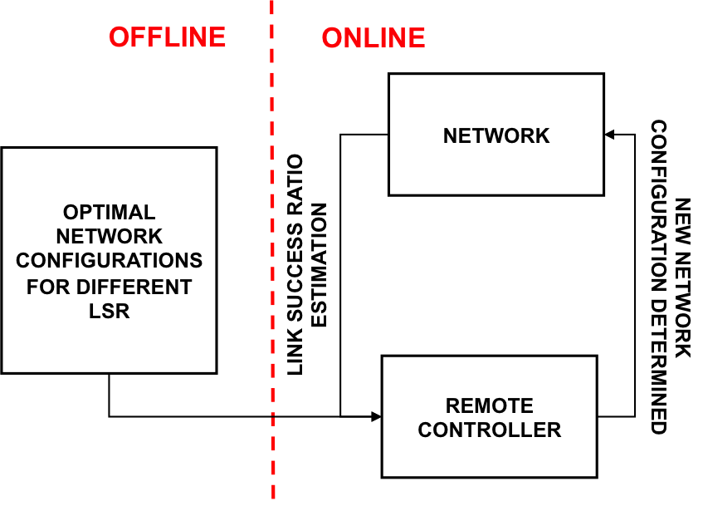
Network Reconfiguration Framework
Input
Network configuration set
Offline
Optimal network configuration table indexed by LSR values.
Online
LSR estimation at run time
Centralized network reconfiguration algorithm
Notes:
This is our proposed network reconfiguration framework. The input is network configuration set. In our case, our network configuration set is network topology set. The framework has offline and online parts. In the offline part, we generate an optimal network configuration table and store the table in the remote controller. At run time, the network will estimate the LSR and sends current LSR estimation to remote controller. The remote controller will choose a new network configuration and distribute the new configuration to the network to do reconfiguration.

Slide 5
Thanks!

Slide 6
Wired vs. Wireless Control System (WCS)
Actuator
Plant
Sensors
Wired
Control System
Not easy to do deployment and maintenance
control signal
Remote
Controller
measurements
Actuator
Plant
Sensors
Wireless
Control System
(WCS)
Wireless Network
control signal
measurements
Remote
Controller
Notes:
Traditionally, control systems are connected by wires. We’re only considering the control system when controllers are on the remote side. The plant is a physical system. The sensors attached to the physical system will send measurement data, such as temperature or pressure to the remote controller periodically and the controller will calculate the action the physical system should do, it’s called control signal and send the control signal to the actuator to actuate the physical system to do that action.
However, using wires in the control system is not easy…
So people replace wires with wireless communication.

Slide 7
Wired vs. Wireless Control System (WCS)
Actuator
Plant
Sensors
Wired
Control System
Not easy to do deployment and maintenance
control signal
Remote
Controller
measurements
Actuator
Plant
Sensors
Wireless
Control System
(WCS)
Network Imperfections
Delay and Message Loss
control signal
measurements
Remote
Controller
Notes:
While the wireless control system can address the problems of the traditional control system, it has its own limitations, Because wireless network can cause network delay and message losses. The controller may get delayed data, wrong data or no data at all, which will affect the calculation of the control signal. The actuator may receive inaccurate control signal or loss the control signal during the transmission. So the network delay and message loss can have bad effect on the control system. They are called network imperfections.

Slide 8
Major Challenge
Performance Degradation [Li ICCPS’16]
Network imperfections can induce additional error, network-induced error
Wired control system output
Wireless control system output
output
Network-induced error
time
Notes:
Network imperfections can bring two major challenges for the control system. First challenge is instability. When the network induces too much delay and message losses, the physical system could be unstable. The plant or part of the plant will be damaged. The other challenge is performance degradation. Network imperfections can induce additional errors, it’s called network-induced error that can degrade the control system performance. For example, the black line is the wired control system output and the red line is the wireless control system output. The difference between them is network-induced error.
Instability: use state equation to quantify (xdot = Ax+Bu), the real-part of the eigen value is negative -> stable

Slide 9
Future Work
Conduct a case study to wirelessly control a non-linear primary heat exchanger system in a small nuclear reactor in nuclear power plant system

Slide 10
Work-in-Progress: Cross-layer Real-Time Scheduling for Wireless Control System
Wenchen Wang, Daniel Mosse, Jason G Pickel, Daniel Cole

Slide 11
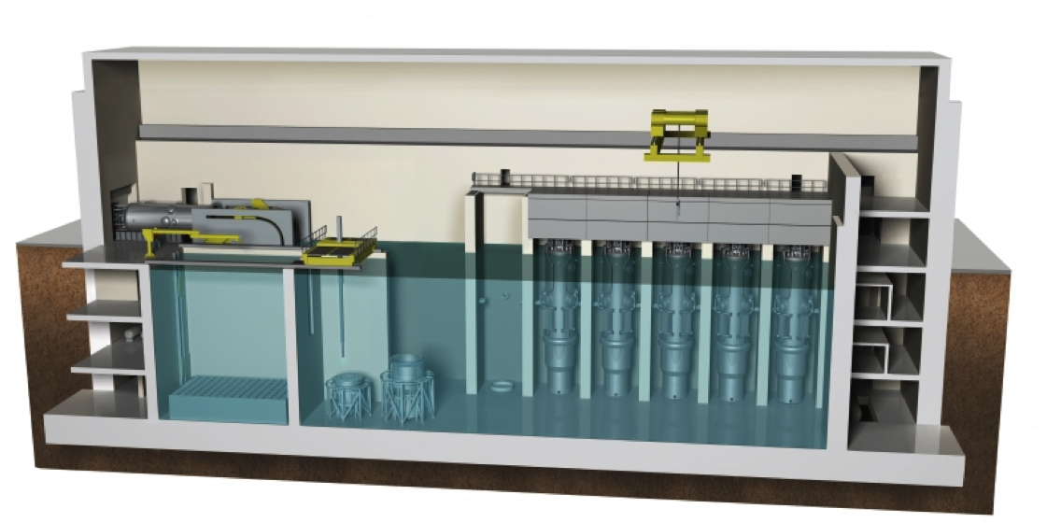
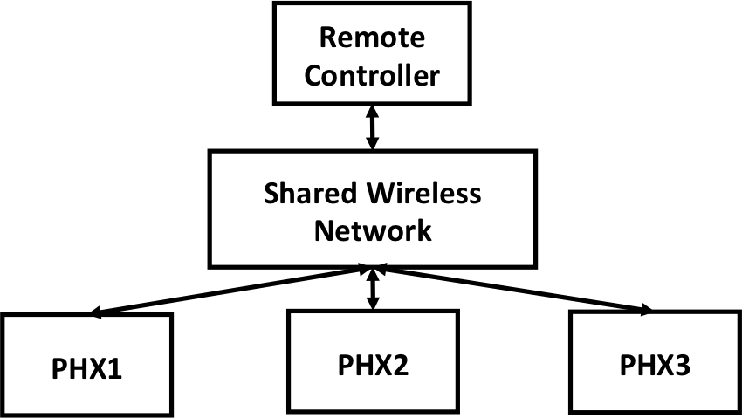
Motivation: NPP demands
Multiple Small Modular Reactors (SMRs) in an NPP
Different SMRs typically have different power demands
Power demands change dynamically, given load consumed
Notes:
Similar to multi-core processor, which is efficient and flexible. In today’s nuclear power plant systems, people use multiple small modular reactors, instead of one large reactor. Different smrs may have different power demands changing dynamically. These are the examples that power demands change over time of two smrs.
In nuclear power plant system, there are multiple small modular reactors. This is a new trend in today’s power plant system, people use several SMRs instead of one large reactor. Each SMR has one primary heat exchanger system. Multiple PHXs use one shared wireless network to transmit measurements. Different SMRs typically have different power demands and power demands can change dynamically, given load consumed. This is an example of two PHXs power demands changing over time.

Slide 12
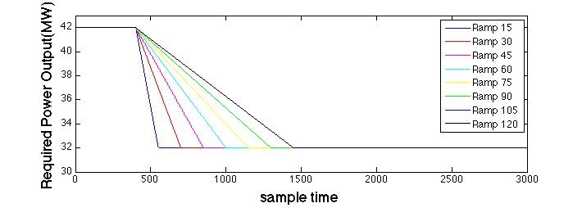
Motivation: observations
Test the network-induced error on one PHX
Different reference functions with one ramp
power change amount (PCA)
power change duration (PCD)
Different delivery ratio and delay
Ramp30
PCA: 10 MW
PCD: 30s
Notes:
These are the reference function examples of one SMR. They all change the power amount from 42 MW to 32 MW, but with different time durations. For example, if the operator wants to change the power within 30s. The reference function will be set to be ramp30. We test these reference functions for different delivery ratio and delay on one reactor.
We did a test on one PHX with different reference functions for different network delays and delivery ratios. These are the examples of reference functions coming from the nuclear control people. For example, if the nuclear operator wants the power of phx to change from 42 MW to 32 MW within 30s. They will set reference function to be ramp30. In our case, a reference function with one ramp is determined with power change amount and power change duration. For example, the PCA of ramp 30 is 10MW and PCD is 30s.

Slide 13
Motivation: observations
Network-induced error
RMSEs are similar
PCA: 10 MW; DR: 0.9
For reference functions with higher ramp ratios, the network delay becomes a more significant factor.
Notes:
We observed that the higher the ramp ratio, the more network-induced error we get. And for reference functions …. For example, the duration 15 with network delay 0.2 perform similar to the duration 45 with network delay 0.4. This motivates us to set smaller measurement deadlines for reference functions with higher ramp ratios.
This is the RMSE results for different PCDs with static PCA and delivery ratio.
For example, the rmse of pcd 15 with delay 0.2 is similar to the rmse of pcd 45 with delay 0.4. But when PCD is greater than 60, the RMSEs are similar.
Note that I make decreases in the X-axis to be visually consistent with the first figure.
This is the RMSE results for different PCAs with static PCD and delivery ratio.
For example, the rmse of PCA 10 with delay 0.2 is similar to the rmse of pca 6 with delay 0.5. But when PCA is greater than 4MW, the RMSEs are similar.

Slide 14
Our Solution
Objective
Reduce total network-induced error for multiple control systems
Cross-layer real-time scheduling
Inject the application demands into the network layer to change measurement deadlines dynamically
Assign smaller deadlines for more urgent application demands
Offline control system analysis
Notes:
Based on the two motivations, we want to reduce total network-induced error for multiple control systems. To achieve that, we will study cross-layer real-time scheduling. We first inject the application demands into the network layer to change measurement deadlines dynamically. Assign smaller deadlines for more urgent application demands. As far as we know the cross-layer real-time scheduling has not been researched in wireless control system yet.

Slide 15
Thanks!

Slide 16
Backup slides

Slide 17
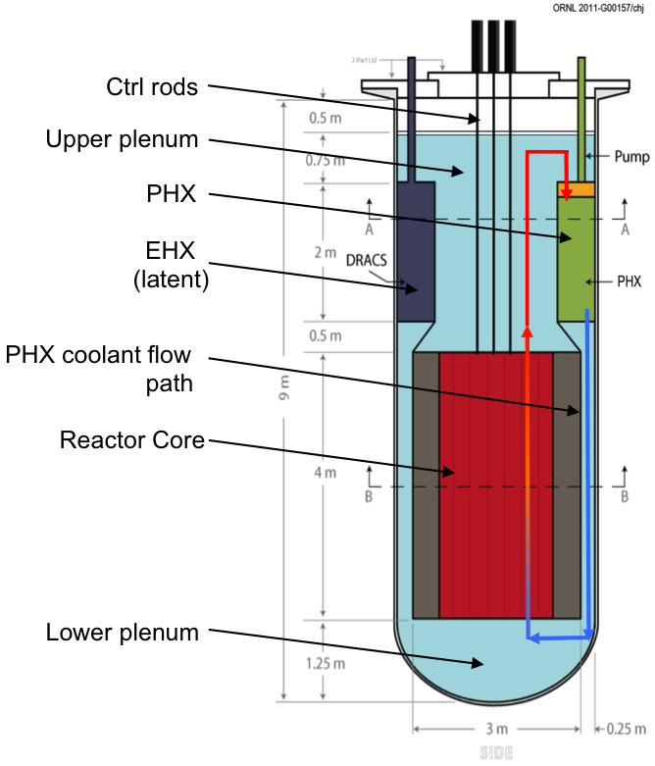
Motivation: NPP demands
Multiple Small Modular Reactors (SMRs) in an NPP
Do you need this slide? Or the next one is sufficient?
Notes:
In addition to the observation motivation, we have another motivation of NPP demands. There are multiple small modular reactors in nuclear power plant, multiple PHXs will use one shared wireless network to transmit measurements. Each SMR may have different power demand, which means different reference functions over time.
Theses two motivations motivates us to do cross-layer real-time scheduling. We will Inject the application demands into the network layer to change measurement deadlines dynamically. Assign smaller deadlines for more urgent application demands (smaller PCDs or larger PCAs). As far as we know the cross-layer real-time scheduling has not been researched in wireless control system yet.

Slide 18
Motivation: Observations
For reference functions with shorter PCDs, the network delay becomes a more significant factor.
RMSEs are similar
PCA: 10 MW; DR: 0.9
For reference functions with higher PCAs, the network delay becomes more significant factor.
RMSEs are similar
PCD: 30s; DR: 0.9
Notes:
This is the RMSE results for different PCDs with static PCA and delivery ratio.
For example, the rmse of pcd 15 with delay 0.2 is similar to the rmse of pcd 45 with delay 0.4. But when PCD is greater than 60, the RMSEs are similar.
Note that I make decreases in the X-axis to be visually consistent with the first figure.
This is the RMSE results for different PCAs with static PCD and delivery ratio.
For example, the rmse of PCA 10 with delay 0.2 is similar to the rmse of pca 6 with delay 0.5. But when PCA is greater than 4MW, the RMSEs are similar.

Slide 19
Motivation: observations
Set a deadline according to the application demands
Small deadline for reference functions with less PCD or more aggressive PCA
Cross-layer dynamic schedule the network flows
Delay has more significant effect on the control system performance
PCD: 30s; PCA: 10MW

Slide 20
Problem Statement
Network flow
A set of end-to-end network flows
associates with one source , a destination , a period , and a deadline,
Control systems application demands
Control systems have different reference functions with multiple ramps
Objective: reduce total network-induced errors for multiple control systems:
PHX1
PHX2
Required Power
time
$$t_{0}$$
$$t_{1}$$
$$t_{2}$$
$$t_{3}$$
$$t_{4}$$
$$t_{5}$$
Notes:
Each flow delivers one measurement to the remote controller. And each network flow associates with one… ;
Different physical systems may have different reference functions with multiple ramps. For example, ref1 has 3 ramps and ref2 has 2 ramps. From time t0 to t1, network flows of ref1 have smaller deadlines than the network flows of ref2. From time t1 to t2, network flows of control system 2 have smaller deadlines than the network flows of control system 1.

